Slide 1
Logistic Regression and Other Classifiers ML on F1 Data Set
Team: GottaGoFast
Deepak Verma, Lezeh Foy, Zachary Lawell

Slide 2
Data Integration & Pre-processing
Added Pit Stops Information - # of Stops, Lap of Last Stop
Added Weather Information - Dry, Mix, Wet
Added # of Safety Car Laps
Converted Fastest Time Lap Time to seconds
Converted Pit stops to Seconds
Calculated age of driver at time of race
Dropped a number of variables:
resultId, raceId, driverId, constructorId, status (at end of race), nationality of driver and constructor, round (in year), year, location, country, name (of circuit)
Dropped a number of NaN and NA values.
Outcome Selected to be Finishing Position
Position 1-10 are points awarded finishes ($ value)- P
Positions > 10 are No Points - N

Slide 3
Final Variables
Numerical:
GridStart
TotalLaps
FastestLapTime
FastestLapSpeed'
QualifyPos
NumPitStops
LastPitStopLap
PitStopTime
SaftetyCarLaps
DriverAge
Categorical:
Driver
Circuit
Constructor
Weather
Outcome:
PointsFinish - P or N
Position Order
Final Data Size:
2738 entries
Points: 1349
No Points: 1389

Slide 4
Method
Split Training/Test as 80/20
Random Seed = 42
Feature selection using Recursive Feature Selection (RFS)
Selection of top 3 features
Logistic Regression
Solver = lbfgs with iteration to avoid no convergence
Decision Tree Classifier
Entropy & Gini
Naive Bayes
MLP Classifier
Iteration until loss was 0.000000001
5 Different Runs using varied variables
All, except Driver category
All, except Constructor Category
All, except Constructor and Driver Category
All, except Constructor, Circuit, and Driver Category
All, except Constructor, Circuit, and Driver and Weather Category

Slide 5
Results - RFS
Run Features | Top 3 Features | Comments
1. minus Driver | Constructor_marussia, Costructor_hrt, Constructor_caterham | Too constructor heavy
2. minus Constructor | Driver_pic, Driver_kovaalainen, Driver_gutierrez | Too driver heavy
3. minus Constructor, Driver | Weather_wet, GridStart, Circuit_albert_park | A specific park was surprising
4. minus Constructor, Circuit, Driver | GridStart, Weather_varied, Weather_wet | Too weather centric
5. minus Constructor, Driver, Circuit, Weather | GridStart, TotalLaps, NumPitStop | TotalLaps was obvious, but PitStop ahead of QualiPosition was surprsing

Slide 6
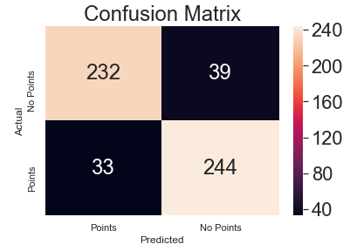
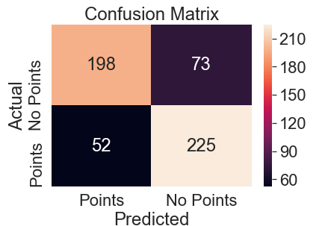
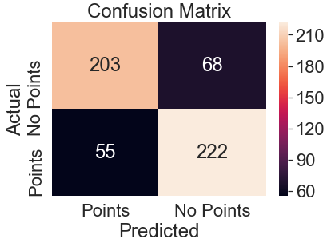
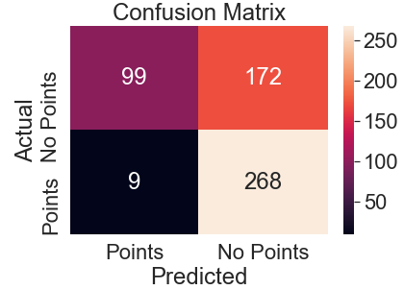
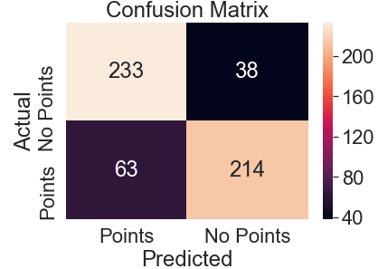
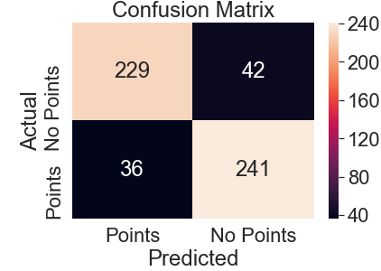
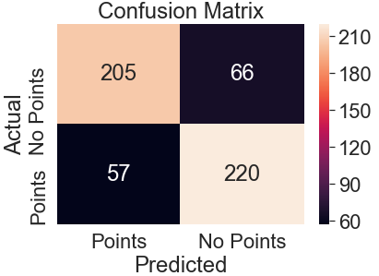
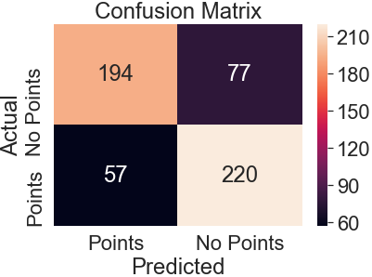
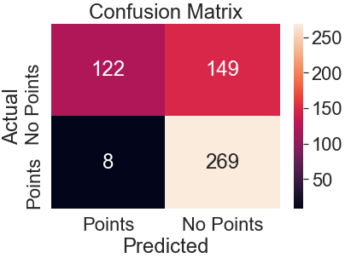
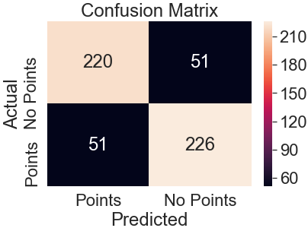
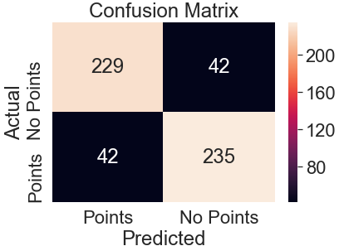
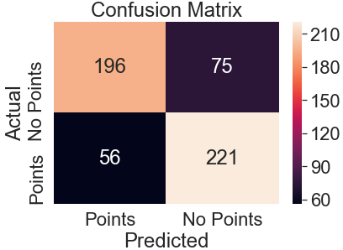
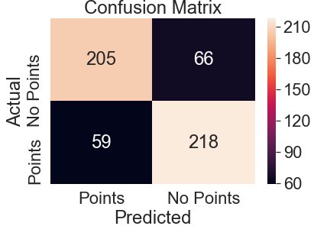
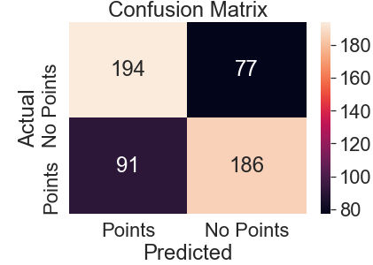

Results - Accuracy and Confusion Matrix
Features | Logistic Regression | Decision Tree - Entropy | Decision Tree - Gini | Naive Bayes | MLP
- Driver | 89.9% | 77.2% | 77.5% | 70.0% | 81.6% 72 itrs.
- Const. | 85.8% | 77.6% | 75.5% | 71.4% | 81.4% 31 itrs.
- Const., Driver | 84.7% | 76.1% | 77.2% | 69.3% | 80.8% 59 itrs.

Slide 7
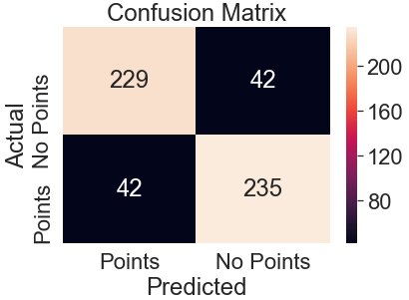
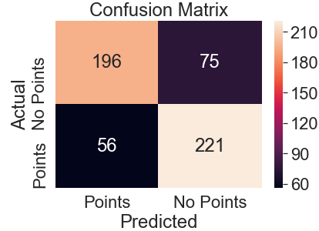
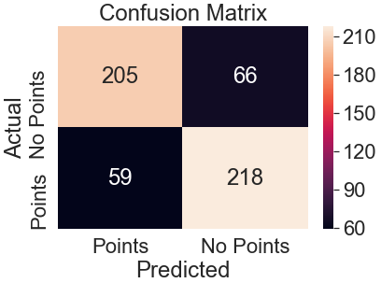
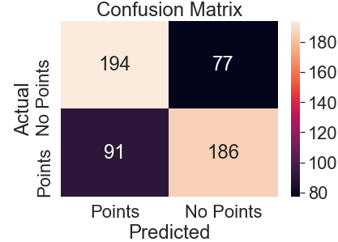

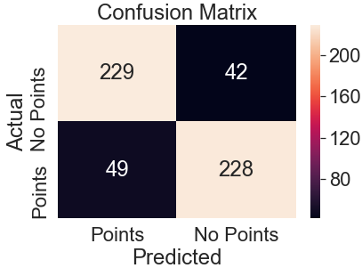
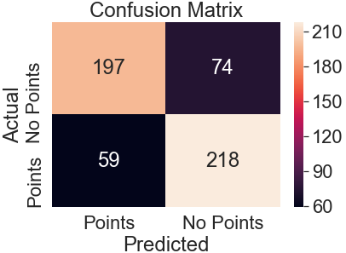

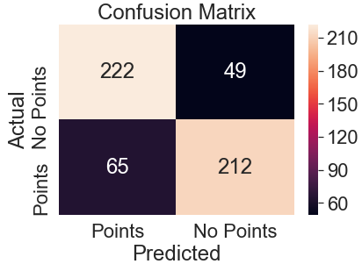
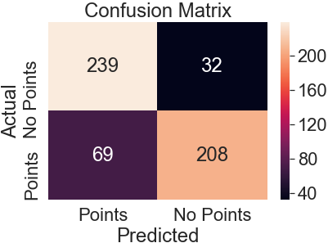
Results - (continued)
Features | Logistic Regression | Decision Tree - Entropy | Decision Tree - Gini | Naive Bayes | MLP
- Const., Driver Circuit | 84.7% | 76.1% | 77.2% | 69.3% | 80.8% 59 itrs.
- Const., Driver Circuit Weather | 83.4% | 75.7% | 78.1% | 79.2% | 81.5% 32 itrs.

Slide 8
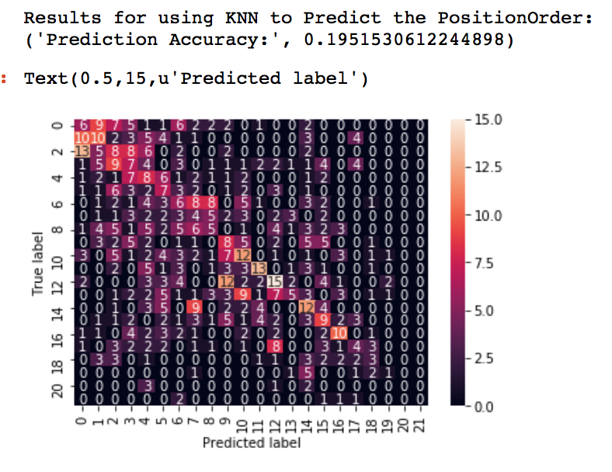
Classifying Race Outcome with KNN (PositionOrder)
Convert all categorical variables to numeric using Category Codes
Used RFE to select the top 5 features for classification
Used KNN with a K value of 5 (arbitrarily selected)
Top 5 features were
driverId
points
laps
fastestLapTime
fastestLapSpeed
Model Accuracy: 19.5%

Slide 9
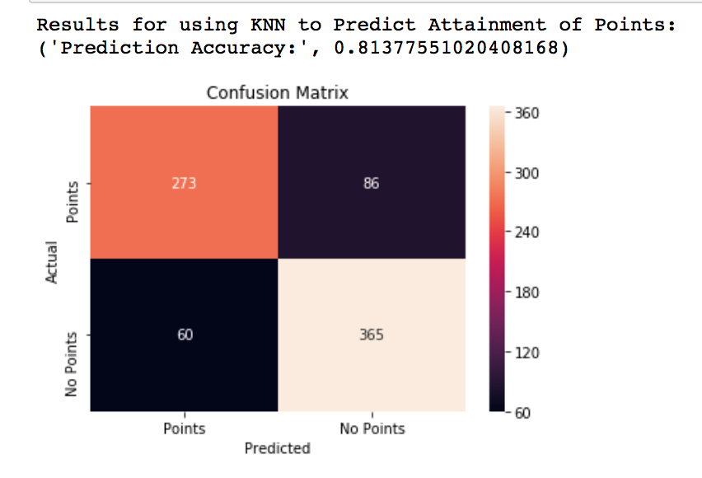
Classifying Race Outcome With KNN (Points)
KNN Model with the following predictors
driverId
positionOrder
laps
fastestLapTime
fastestLapSpeed
Model Accuracy 81.3%
It’s easier to Model attainment of points versus actual position in a sporting event

Slide 10
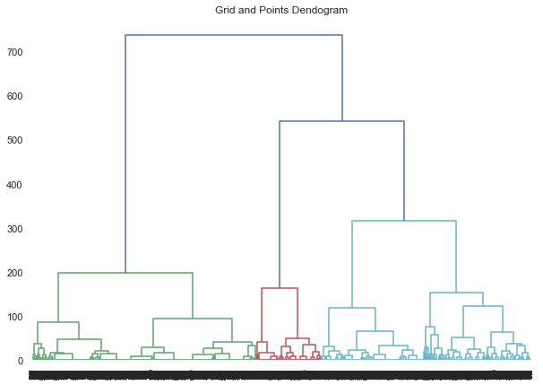
Clustering Method
Performed cluster analysis on 12 pairs of
data amongst 7 variables
Began each analysis with hierarchical
clustering via dendrogram, then grouped
data points into k clusters, and plotted their
array into a scatter-plot (used Ward’s method)
Created k-means scatterplot to compare to
each ward’s method scatterplot
Used elbow method to assist in determining
appropriate number of clusters
Grid and Points Dendrogram

Slide 11
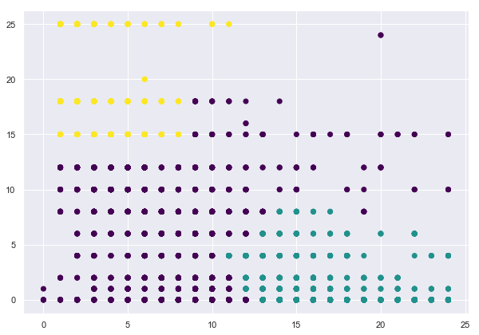
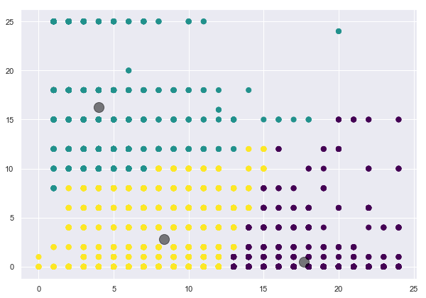
Cluster Results
Points
Grid
Points over 25 were dropped (outliers)
Those behind the 10th-12th position on the starting grid tended to earn less points/race than those starting 1st-10th

Slide 12
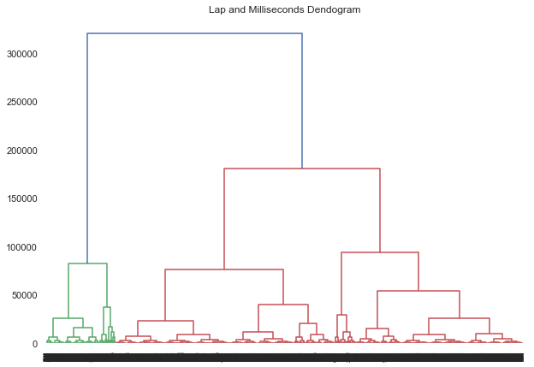
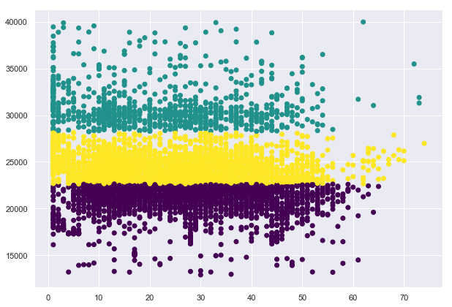
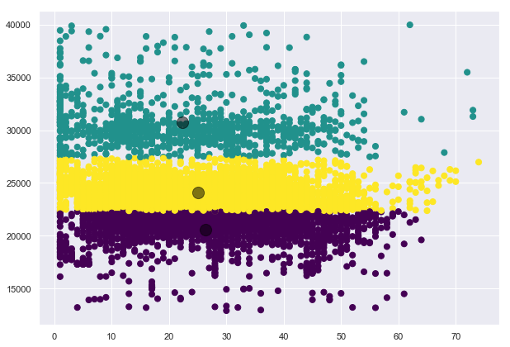
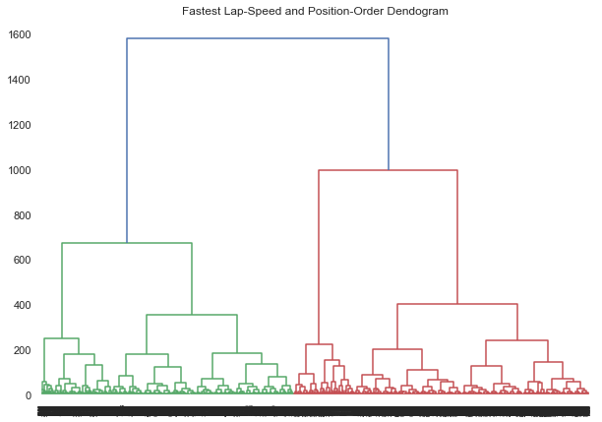
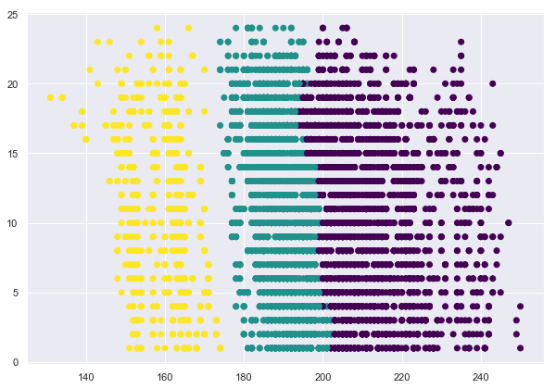
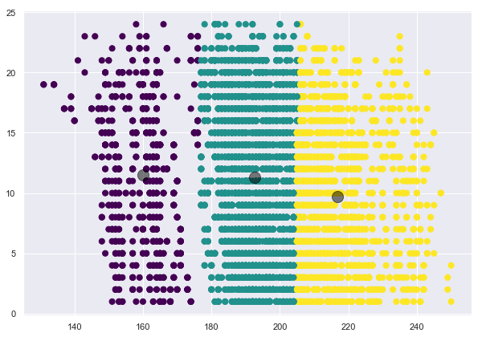
Additional Cluster Results
Milliseconds
Lap (pit stop is taken) and Milliseconds Dendrogram
PositionOrder
Lap
Fastest Lap-Speed
Fastest Lap-Speed and Position-Order Dendrogram

Slide 13
Observations
Overall accuracy using classifier methods did not exceed 89.9%, though given the nature of this data set it is likely that the model over-fitted to the available set.
Logistic Regression provided the highest accuracy, least false positives and false negatives, whilst naive bayes was the least accurate
MLP was very consistent though required more iterations as categorical variables were added.
Adding categorical variables increased accuracy for LR and MLP, but reduced for KNN
Predicting 1 winner (or order of finishes) has very low accuracy, predicting points was much easier.
Majority of data segmentation reduced to three clusters, some were reduced to as few as two
Grid, Position-Order, Milliseconds and Lap produced the most interesting clustering patterns
Code at https://github.com/dvermagithub/GottaGoFast

Slide 14
Thank You

